Slide 1
The funnels
The funnels

Slide 2
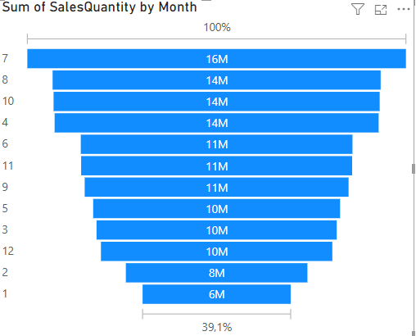
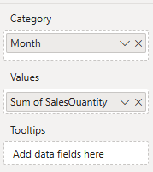
The funnels
This lab uses the Sales2019823.xls file of Excel sources
Add the Funnel visualization to the scene and configure the parameter values as shown in the table

Slide 3
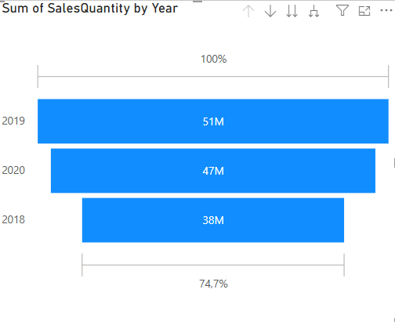
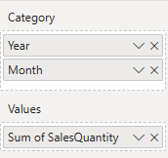
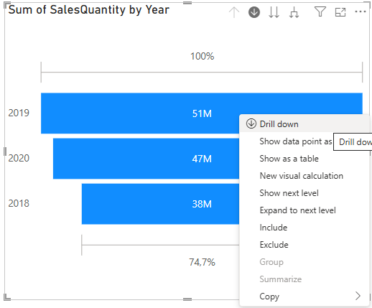
The funnels
Add year the Category field and observe the changes

Slide 4
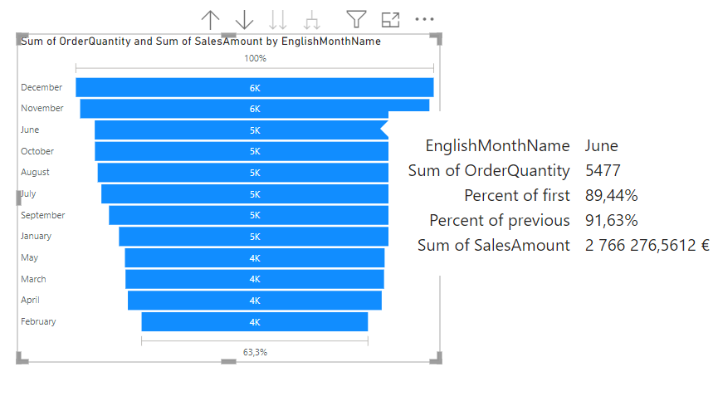
The funnels
Try hovering over one of the histograms

Slide 5
Thank you
Thank you

